Slide 1
Summer School
Advanced Structural Dynamics
June 16th-19th 2025, Copenhagen (Denmark)
Fast-slow motion analysis
for friction-related problems
Lecture 3
Lecturer: Alessandro Cabboi
Assistant Professor and Acting Section Head
Section of Mechanics and Physics of Structures
Department of Engineering Structures
Faculty of Civil Enginering and Geosciences
Email: A.Cabboi@tudelft.nl

Slide 2
Outline of the lectures
Lecture 1 – 9:00-10:00
- Personal background
- Case studies of fast-slow motion analysis for friction-related problems
- Simplified and intuitive example of fast-slow motion analysis for sliding friction
Lecture 2 – 13:10-14:00
- Mass-spring system influenced by friction for a general frequency of excitation
- Worked-out example of fast-slow motion analysis for a pile driving system
Lecture 3 – 14:00-15:00
- Follow-up: worked-out example of fast-slow motion analysis for a pile driving system
- Example of results of the friction reduction of a SDOF moving on an elastic rod
- Discussion on hidden (fast) motion effect on stability and dynamic friction laws

Slide 3
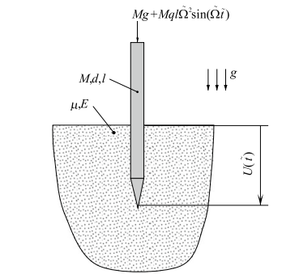
Example 2: application on a vibration-assisted pile driving system
Suggested exercise from J.J. Thomsen’s book (see problem 7.3, 3rd edition).
Set up an equation governing the slow (i.e. average) component of the penetration displacement.
Simplify this equation for the case of a relatively small average piling speed.
Derive and discuss an expression for the vibrational force acting on the pile (i.e. the static force equivalencing the average effect of the fast vibrations).
We use this adimensional equation of motion:
This term links the friction force to the lateral normal force exerted by the soil on the pile, as a linear function with respect to penetration depth

Slide 4
Example 2: application on a vibration-assisted pile driving system
Original equation:
Equation which accounts for the averaged effect induced by the fast motion, on the slow motion:
The original equation can be re-rewritten in a different form, without the external forcing, but adding a so-called vibrational force that includes the averaged effect of the fast excitation
Vibrational force
To an observer, who is “blind to the applied excitation”, it will appear that the pile’s motion is influenced by a “mysterious” force V.

Slide 5
Example 2: application on a vibration-assisted pile driving system
The vibrational force has two terms in this case:
A restoring force which is pointing in the direction of pile penetration
A term which dissipates energy. The dissipation increase with z, but decreases if the externally applied excitation is increased
Important take-away: Not being aware of the applied excitation, may lead to the conclusion that the observed pile behaviour, during pile-driving, is governed by a complex “force”, that seems to be proportional to the displacement and the velocity

Slide 6
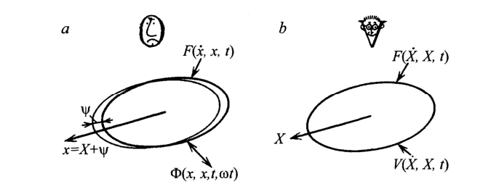
Overview of the notion of Vibrational forces
according to Blekhman
The world/observer of
”mechanics”
The world/observer of
” vibrational mechanics”
If you experience/observe vibrational forces, look for hidden fast motions first.
Images taken from: I. I. Blekhman. Vibrational mechanics: Nonlinear dynamic effects, general approach, applications, World Scientific Publishing, (2000)

Slide 7
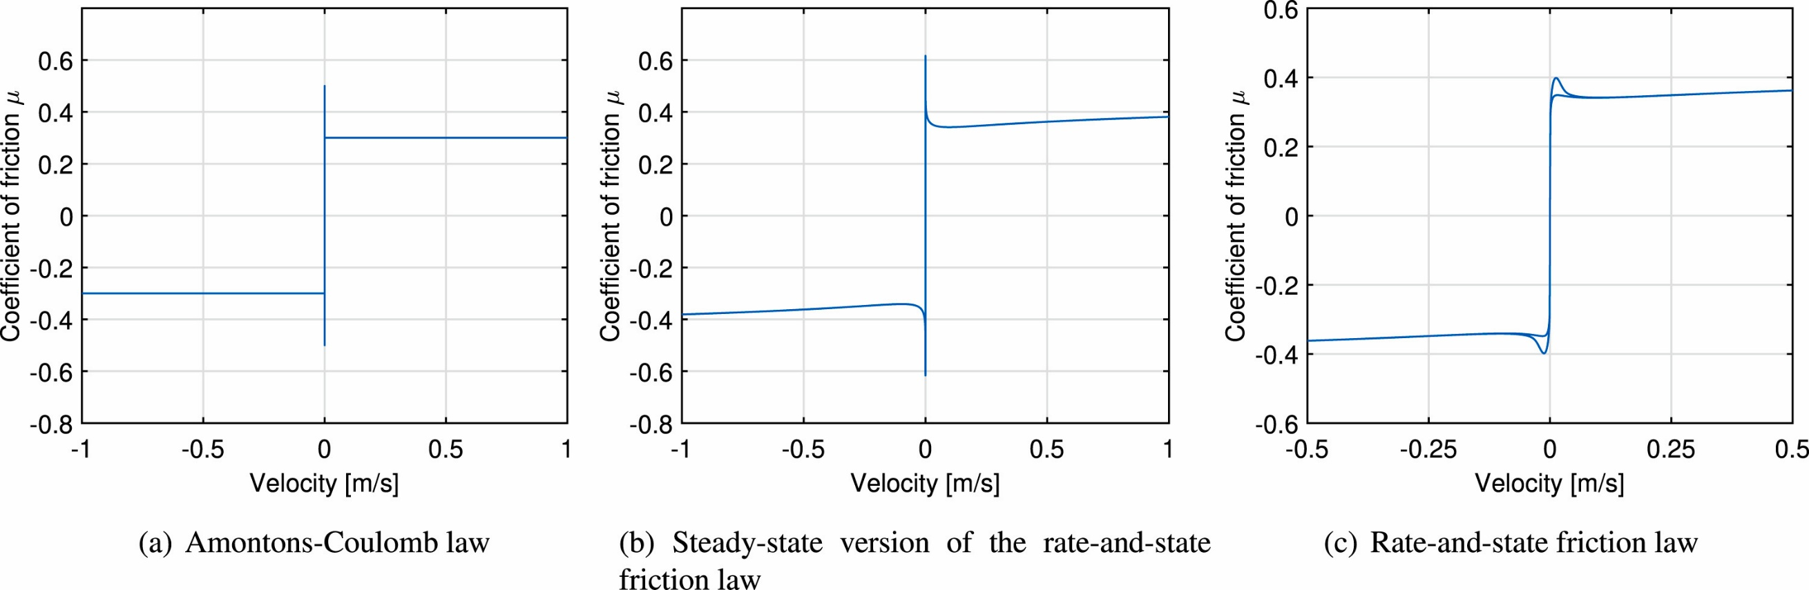
Examples of kinetic and dynamic friction laws
Image taken from: Cabboi, A., Marino, L., Cicirello, A. A comparative study between Amontons–Coulomb and Dieterich–Ruina friction laws for the cyclic response of a single degree of freedom system, European Journal of Mechanics – A/Solids, 96, 104737 (2022).

Slide 8
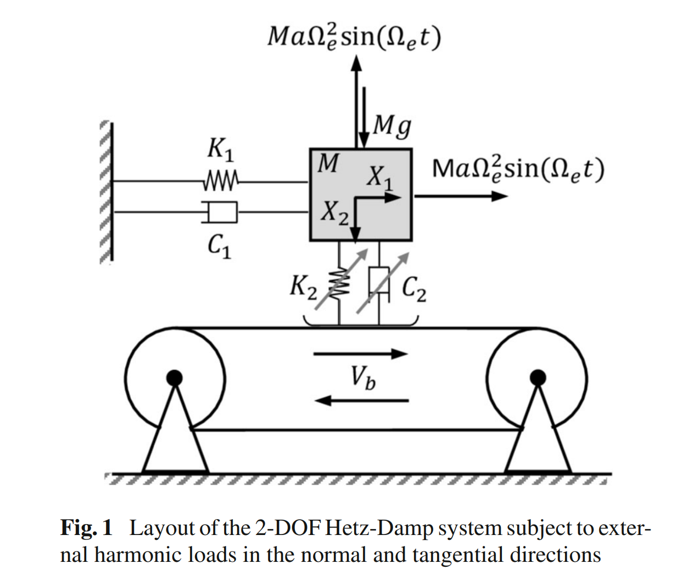
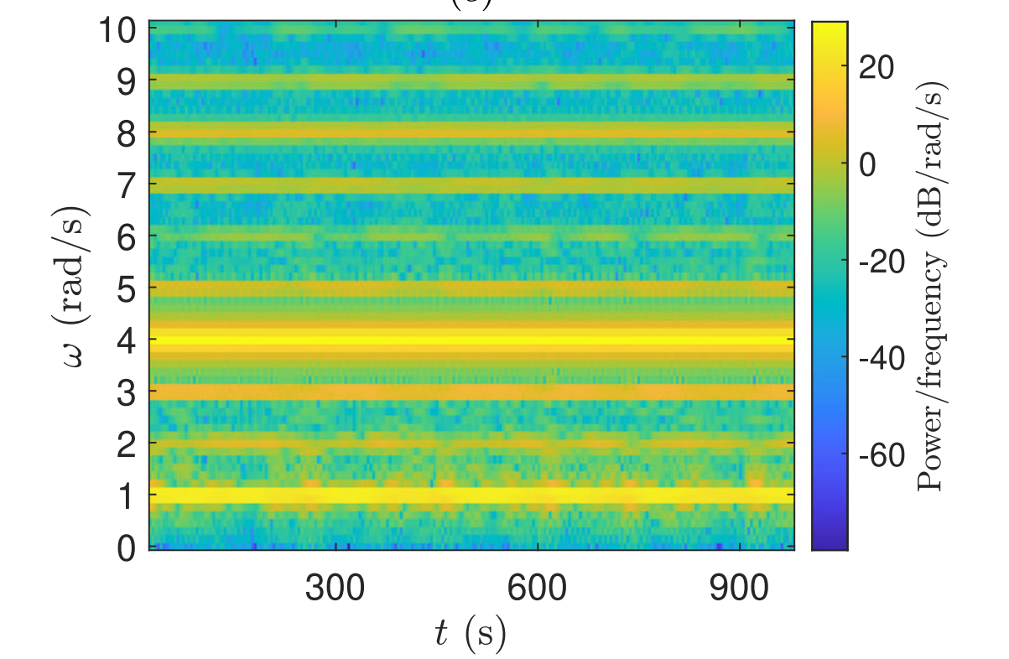
Typical examples of vibrational forces can occur for systems influenced by friction and vibration
The effective friction force will be modulated through the tangential and normal harmonic excitation
It can lead to instability, due to the parametric excitation
Applied excitation (tang. and norm): 4 rad/s
Tang. Natural frequency: 1 rad/s
Images taken from: Sulollari, E., Van Dalen, K., Cabboi, A. Parametric excitation and friction modulation for a forced 2-DOF system, Nonlinear Dynamics, 113, (2025)

Slide 9
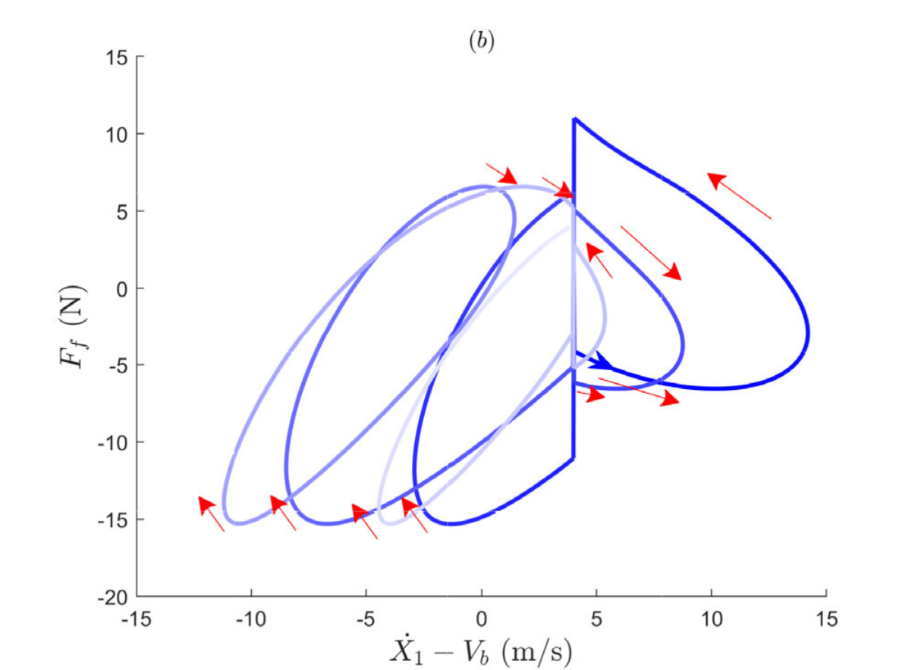
Typical examples of vibrational forces can occur for systems influenced by friction and vibration
The effective/modulated friction force looks like:
It exhibits the behaviour of dynamic friction laws
It can be characterized by negative damping (negative slope of the friction force vs relative velocity)
Note: If one were to fit/develop a vibrational friction force exhibiting hysteresis and negative damping, according to the vibrational mechanic observes, the system could be solved in a simpler way. However, you may miss the underlining physics of the system
Images taken from: Sulollari, E., Van Dalen, K., Cabboi, A. Parametric excitation and friction modulation for a forced 2-DOF system, Nonlinear Dynamics, 113, (2025)

Slide 10
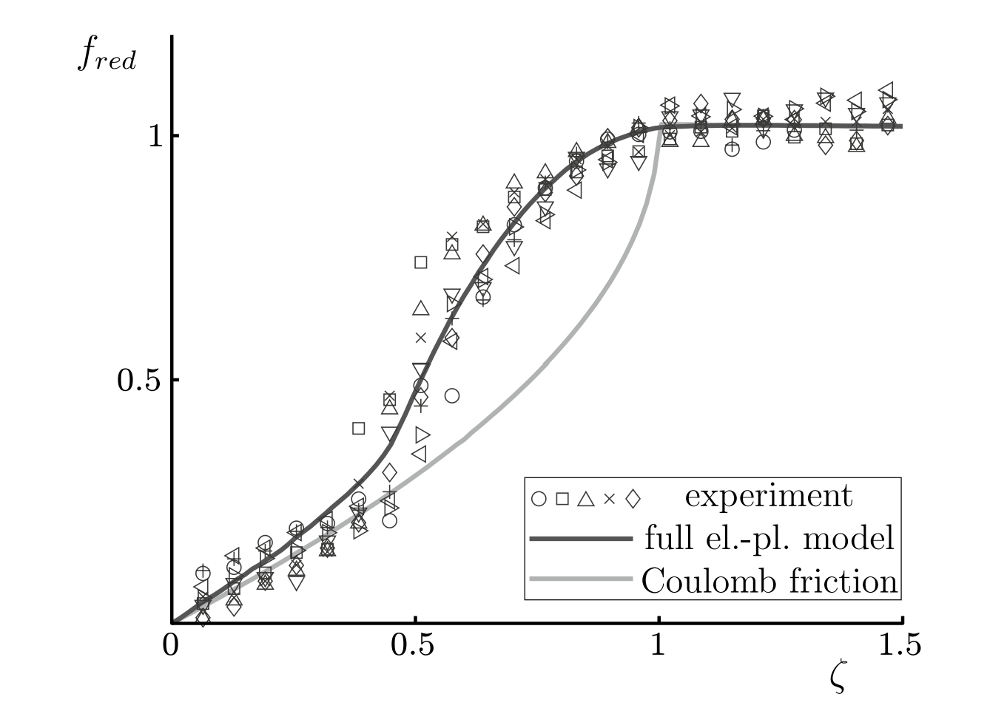
Typical examples of vibrational forces can occur for systems influenced by friction and vibration
Kapelke, S. et al (2018)
Kapelke et. al, had to use an Elasto-plastic friction (Dupont model), to fit the observed friction reduction, due to fast excitation.
Can the observed behaviour of the friction reduction be explained in a different way?
What if the fast-external excitation was triggering a system dynamic response, which was not accounted for?
Image taken from: Kapelke, S. et al, On the effect of longitudinal vibrations on dry friction, Tribology Letters (2018) 66:79, https://doi.org/10.1007/s11249-018-1031-0

Slide 11
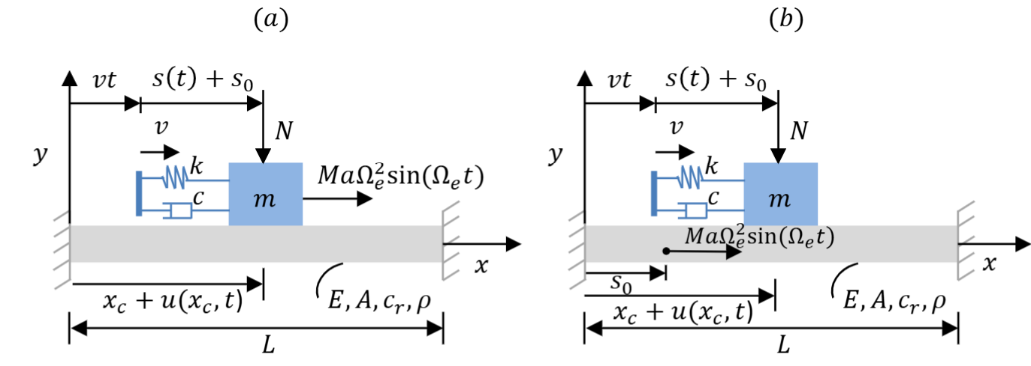
Typical examples of vibrational forces can occur for systems influenced by friction and vibration
We assumed a fast-harmonic excitation, applied on a friction oscillator, which is being pulled over an axial deformable rod (inclusion of fast motion provided by the system dynamics).
Images taken from: E. Sulollari, K.N. van Dalen, A. Cabboi, Vibration-induced friction modulation for an oscillator moving on an elastic rod, Submitted to the International Journal of Solids and Structures (currently under review)

Slide 12
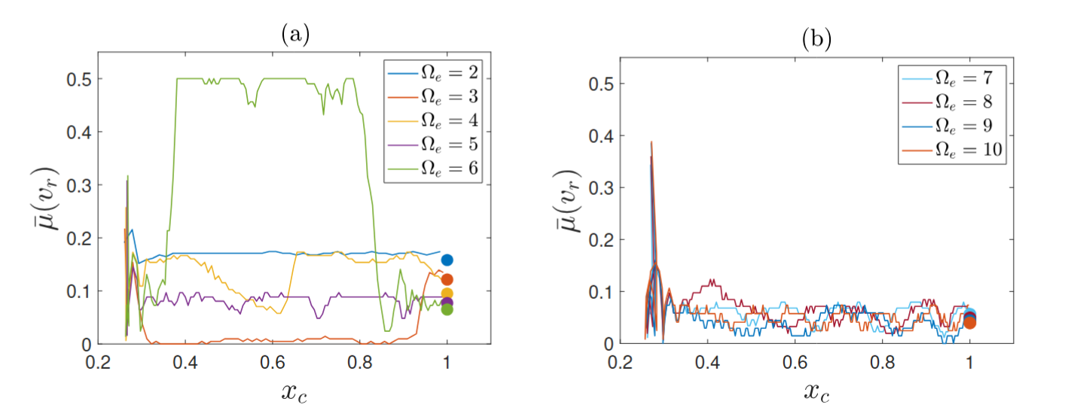
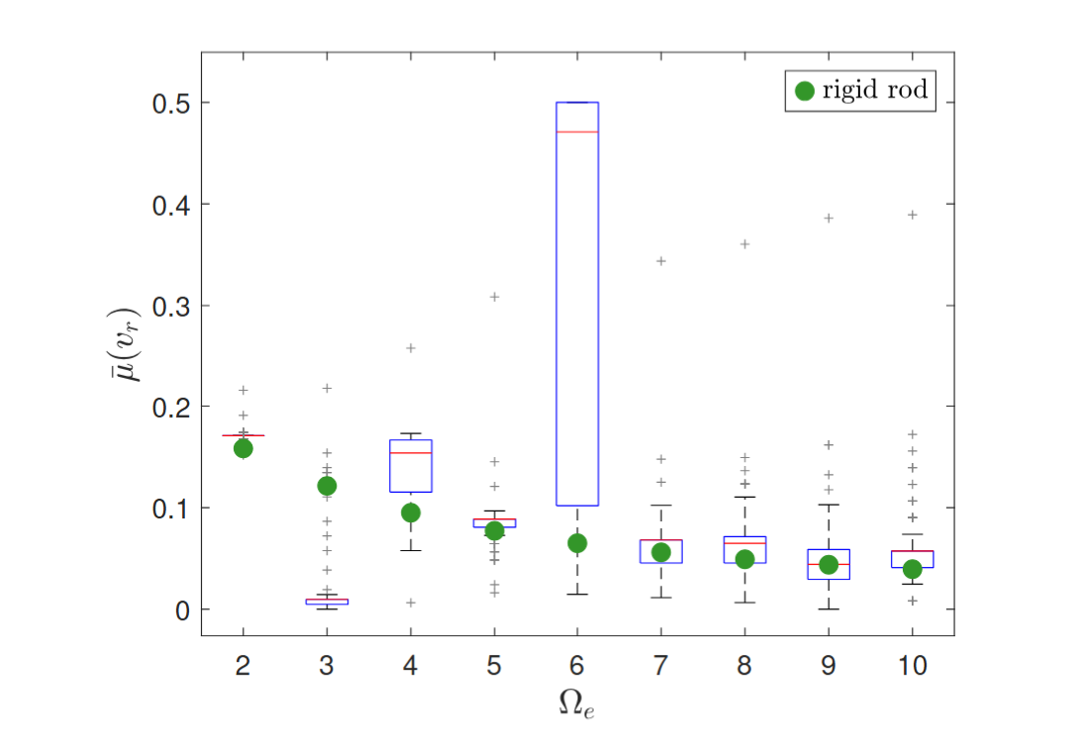
Summary of results: Averaged friction reduction throughout the length of the elastic rod

Slide 13
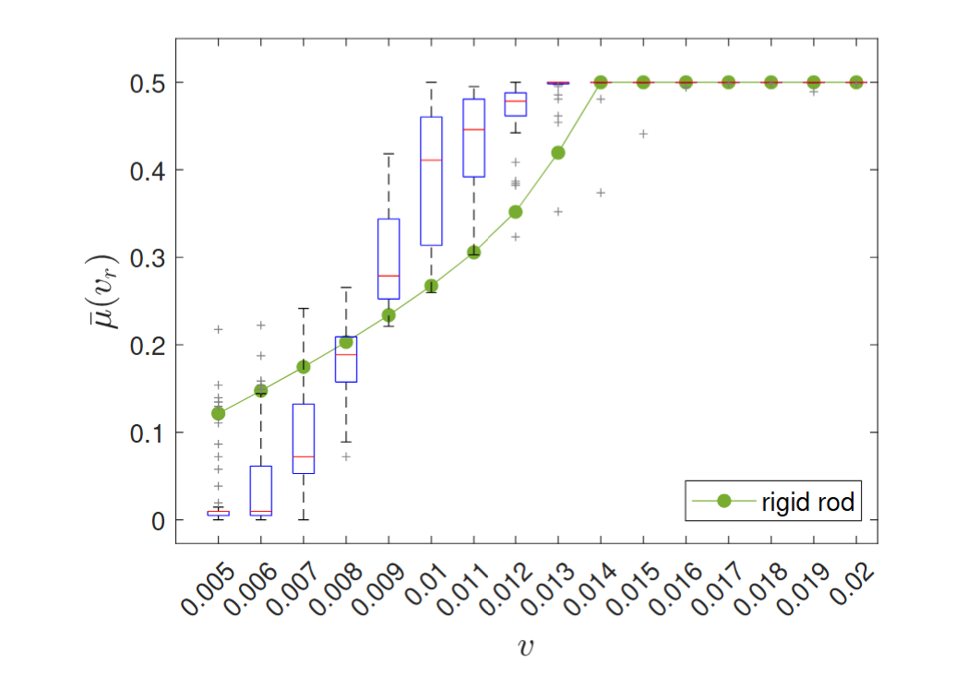
Example 1: Forced SDOF moving on a rotating belt
We can observe deviation from the rigid case.

Slide 14
Last slide and main take-away
Watch out for hidden motions, in order to explain “mysterious” behaviors of the system’s dynamic response
The effect of fast motion, can be tackled through the method of separation of motion, applicable for a general class of systems
Homework: feel free to come up with techniques and solutions, that can take advantage of an applied fast motion.

